Slide 1
BAMBOO
Continuous Integration Tool

Slide 2
Agenda
Continuous Integration
What is Bamboo?
What problem does Bamboo solve?
How does Bamboo do this?
How is a Bamboo workflow organized?
Advantages of using Bamboo

Slide 3
Continuous Integration
CI is a software development methodology in which a build, unit tests and integration tests are performed, or triggered, whenever code is committed to the repository, to ensure that new changes integrate well into the existing code base.
Changes are delivered in small, rapid increments, instead of a single delivery.

Slide 4
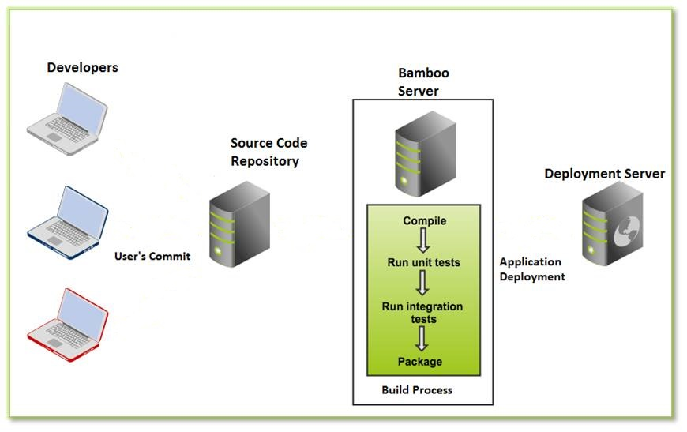
Continuous Integration

Slide 5
Continuous Integration
Automate every time a change is made in source control, the system is built, deployed and all tests are run.
Integration builds provide early 'fail fast' feedback on the quality of new changes.
Fix failure builds ASAP.

Slide 6
Bamboo
Bamboo is a continuous integration server from Atlassian, the makers of JIRA, Confluence and Crowd.
Bamboo supports builds in any programming language using any build tool, including Ant, Maven, Make, and any command line tools. Build notifications can be customized based on the type of event, and received via email, instant message, or pop-up windows in Eclipse-based IDEs.

Slide 7
What problem does Bamboo solve?
An automated, and therefore reliable, build and test process, leaving you free to code more.
A way to manage builds that have different requirements or targets. your build and test process is not dependent on a specific local environment.
Can optimize build performance through parallelism.

Slide 8
What problem does Bamboo solve?
Builds and integration tests are triggered automatically as soon as a developer commits code (continuous integration).
Automatic deployment to a server, can deploy continuously and implement release management process.

Slide 9
How does Bamboo do this?
Bamboo is the central management server which schedules and coordinates all work and it has interfaces and plugins for lots of types of work.
Bamboo first gets your source from a source repository (lots of plugins available for a variety of systems).
Bamboo starts the build - that can be done by calling something like MSBuild to build your Visual Studio solution, or Ant, Maven to call your compiler and linker - whatever you use.

Slide 10
How does Bamboo do this?
Once your project is built, you have "artifacts" (build results, for example, an executable app, config files, etc.).
Can do additional things with the build artifacts like zip them up into a ZIP file and copy them somewhere or run an install builder on them and create an MSI or install them on a test server to make sure everything installs just fine.
Bamboo provides a web front-end for configuration and for reporting the status of builds.

Slide 11
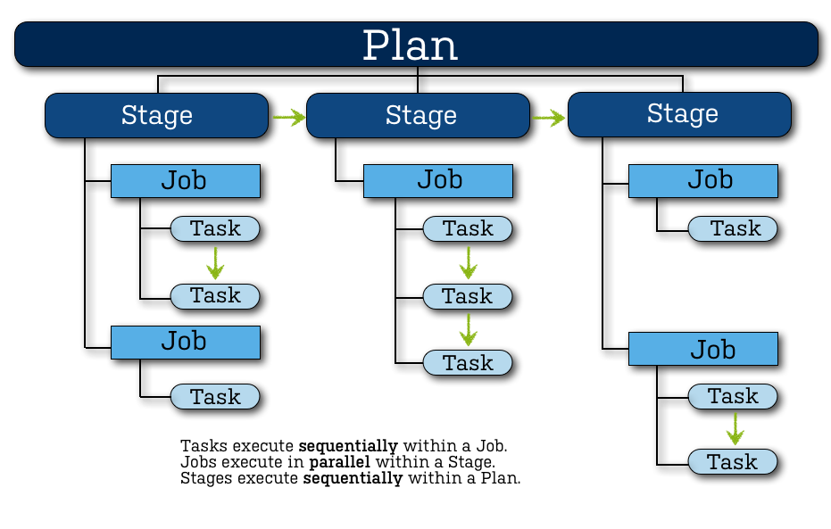
How is a Bamboo workflow organized?

Slide 12
How is a Bamboo workflow organized?
Bamboo uses the concept of a 'plan' with 'jobs' and 'tasks' to configure and order the actions in the workflow.
Project
Has one, or more, plans.
Provides reporting (using the wallboard, for example) across all plans in the project.
Provides links to other applications.

Slide 13
How is a Bamboo workflow organized?
Plan
Has a single stage, by default, but can be used to group jobs into multiple stages.
Specifies the default repository.
Specifies how the build is triggered, and the triggering dependencies between the plan and other plans in the project.
Specifies notifications of build results.
Specifies who has permission to view and configure the plan and its jobs.
Provides for the definition of plan variables.

Slide 14
How is a Bamboo workflow organized?
Stage
Has a single job, by default, but can be used to group multiple jobs.
Processes its jobs in parallel, on multiple agents (where available).
Must successfully complete all its jobs before the next stage in the plan can be processed.
May produce artifacts that can be made available for use by a subsequent stage.

Slide 15
How is a Bamboo workflow organized?
Job
Processes a series of one or more tasks that are run sequentially on the same agent.
Controls the order in which tasks are performed.
Collects the requirements of individual tasks in the job, so that these requirements can be matched with agent capabilities.
Defines the artifacts that the build will produce.
Can only use artifacts produced in a previous stage.
Specifies any labels with which the build result or build artifacts will be tagged.

Slide 16
How is a Bamboo workflow organized?
Task
Is a small discrete unit of work, such as source code checkout, executing a Maven goal, running a script, or parsing test results.
Is run sequentially within a job on a Bamboo working directory.

Slide 17
Advantages of using Bamboo
Bamboo will integrate closely with other products in Atlassian ecosystem.
Bamboo handle multiple languages
It has out of the box support for multiple languages. Customers use it with Java, .Net, PHP, JavaScript etc. That being said, most build servers are generic enough to at least execute a script that can kick off your build process.

Slide 18
Advantages of using Bamboo
Powerful build agent management
Use the Agent Matrix to visualize the system requirements for each of your builds, and see which agents have the capabilities to meet them. Better still, every time you add a build or deploy step, Bamboo tells you how many agents are capable of executing it.

Slide 19
Advantages of using Bamboo
First-class support for deployments
Bamboo lets you to send a continuous flow of builds to test environments, yet ship releases to customers only when you're ready–all while maintaining links to the issues and commits behind them. Consider the gap between dev and ops "bridged".﻿

Slide 20
THANK YOU

